Slide 1

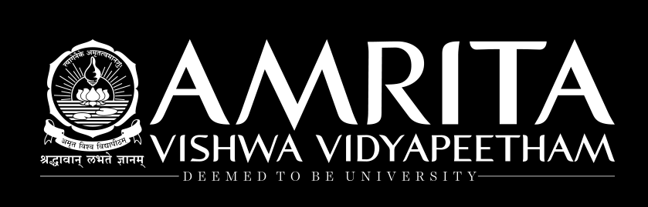
Support Vector Machines
Dr. Hemalatha
AmritaWNA
Amrita Vishwa Vidyapeetham
Notes:
https://www.amrita.edu/news/amrita-surya-vahini-solar-auto-rickshaw

Slide 2
History of SVM
SVM is related to statistical learning theory [3]
SVM was first introduced in 1992 [1]
SVM becomes popular because of its success in handwritten digit recognition
1.1% test error rate for SVM. This is the same as the error rates of a carefully constructed neural network, LeNet 4.
See Section 5.11 in [2] or the discussion in [3] for details
SVM is now regarded as an important example of “kernel methods”, one of the key area in machine learning
[1] B.E. Boser et al. A Training Algorithm for Optimal Margin Classifiers. Proceedings of the Fifth Annual Workshop on Computational Learning Theory 5 144-152, Pittsburgh, 1992.
[2] L. Bottou et al. Comparison of classifier methods: a case study in handwritten digit recognition. Proceedings of the 12th IAPR International Conference on Pattern Recognition, vol. 2, pp. 77-82.
[3] V. Vapnik. The Nature of Statistical Learning Theory. 2nd edition, Springer, 1999.

Slide 3
Introduction to SVM formulation
SVMs belong to the class of supervised learning algorithms in which the learning machine is given a set of examples (or inputs) with the associated labels (or output values). As in the case of decision tress, the examples are in the form of attribute vectors, so that the input space is a sub-set of R^{n} .
SVMs construct a hyperplane that separates two classes (this can be extended to multiclass problems). While doing so, the SVM algorithm tries to achieve maximum separation between the classes

Slide 4
Linear Classifiers
Estimation:
x
f
y^{est}
f(x,w,b) = sign(w. x - b)
denotes +1
denotes -1
w: weight vector
x: data vector
How would you classify this data?

Slide 5
Linear Classifiers
α
x
f
y^{est}
f(x,w,b) = sign(w. x - b)
denotes +1
denotes -1
How would you classify this data?

Slide 6
Linear Classifiers
α
x
f
y^{est}
f(x,w,b) = sign(w. x - b)
denotes +1
denotes -1
How would you classify this data?

Slide 7
Linear Classifiers
α
x
f
y^{est}
f(x,w,b) = sign(w. x - b)
denotes +1
denotes -1
How would you classify this data?

Slide 8
Linear Classifiers
α
x
f
y^{est}
f(x,w,b) = sign(w. x - b)
denotes +1
denotes -1
Any of these would be fine..
..but which is best?

Slide 9
Classifier Margin
α
x
f
y^{est}
f(x,w,b) = sign(w. x - b)
denotes +1
denotes -1
Define the margin of a linear classifier as the width that the boundary could be increased by before hitting a datapoint.

Slide 10
Maximum Margin
α
x
f
y^{est}
f(x,w,b) = sign(w. x - b)
denotes +1
denotes -1
The maximum margin linear classifier is the linear classifier with the, um, maximum margin.
This is the simplest kind of SVM (Called an LSVM)
Linear SVM

Slide 11
Maximum Margin
α
x
f
y^{est}
f(x,w,b) = sign(w. x + b)
denotes +1
denotes -1
The maximum margin linear classifier is the linear classifier with the, um, maximum margin.
This is the simplest kind of SVM (Called an LSVM)
Support Vectors are those datapoints that the margin pushes up against
Linear SVM

Slide 12
Why Maximum Margin?
f(x,w,b) = sign(w. x - b)
denotes +1
denotes -1
The maximum margin linear classifier is the linear classifier with the, um, maximum margin.
This is the simplest kind of SVM (Called an LSVM)
Support Vectors are those datapoints that the margin pushes up against

Slide 13
Introduction to SVM formulation
Separating the classes with a large margin minimises a bound on the expected generalisation error.
A ‘minimum generalisation error’ , means that when new examples (data points with unknown class values) arrive for classification, the chance of making an error in the prediction (of the class which it belongs) based on the learned classifier (hyperplane) should be minimum.
Intuitively, such a classifier is one which achieves maximum seperation-margin between the classes.

Slide 14
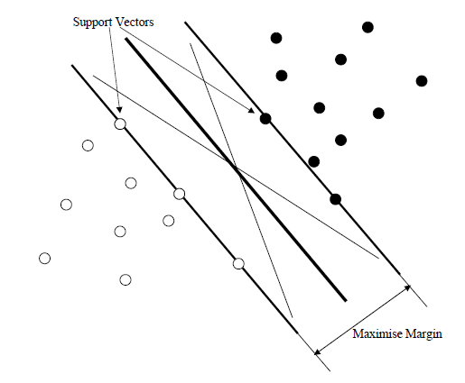
Introduction to SVM formulation
The Figure illustrates the concept of ‘maximum margin’. The two planes parallel to the classifier and which pass through one or more points in the data set are called ‘bounding planes’.
The distance between these bounding planes is called the ‘margin’ and SVM ‘learning’, means, finding a central hyperplane which maximises this margin.
The points (in the dataset) falling on the bounding planes are called ‘support vectors’ These points play a crucial role in the theory and hence the name support vector machines. ‘Machine’, means algorithm.
Hyperplane
Bounding plane
Linear SVM classifier

Slide 15
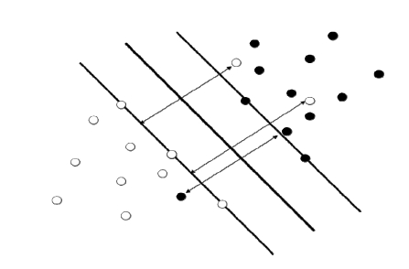
Introduction to SVM formulation
In the case, wherein the data points are shown in the figure here, one may simply minimize the number of misclassifications whilst maximising the margin with respect to the correctly classified examples. In such a case it is said that the SVM training algorithm allows a training error.
Hyperplane
Bounding plane
Linear SVM classifier with training errors

Slide 16
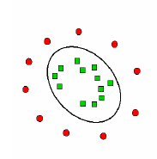
Introduction to SVM formulation
There may be another situation wherein the points are clustered such that the two classes are not linearly separable as shown in Figure here.
That is, if one tries for a linear classifier, it may have to tolerate a large training error.
In such cases, one prefers non-linear mapping of data into some higher dimensional space called ‘feature space’, F, where it is linearly separable
Data that is not linearly separable

Slide 17
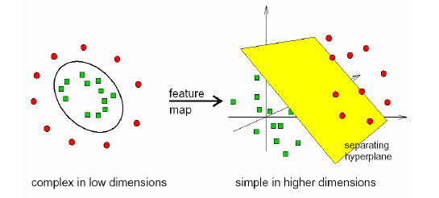
Introduction to SVM formulation
In order to distinguish between these two spaces, the original space of data points is called ‘input space’.
The hyperplane in ‘feature space’ corresponds to a highly non-linear separating surface in the original input space.
Hence the classifier is called a non-linear classifier.
Non linear classifier

Slide 18
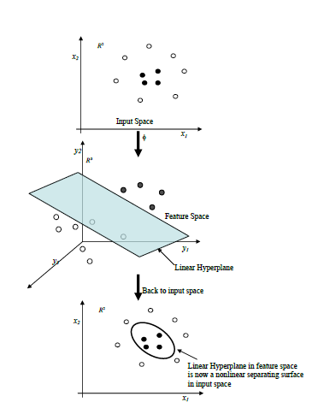
Introduction to SVM formulation
Mapping process

Slide 19
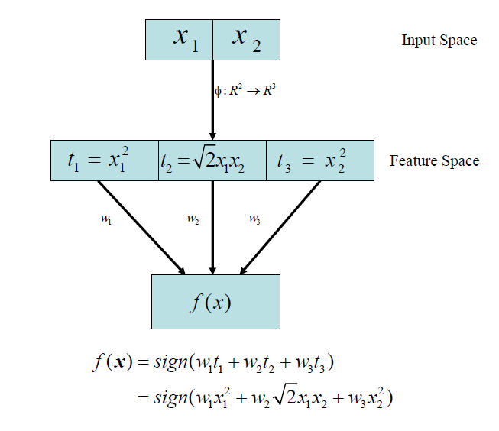
Introduction to SVM formulation
Input space and Feature space

Slide 20
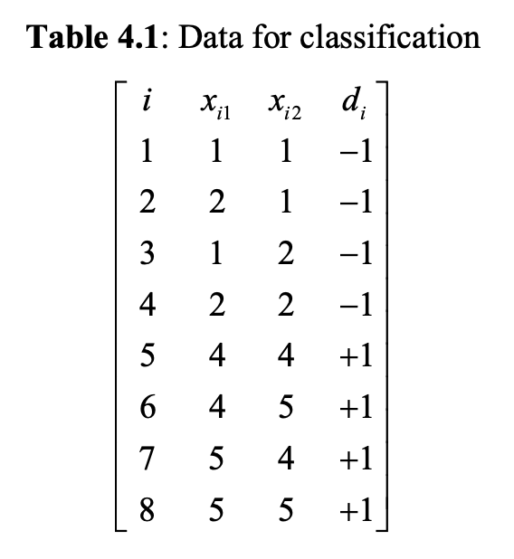
SVM formulation with two variables
Consider 8 data points given in the following Table.
In the table, ‘ i ‘ is the index of the point and two variable values are given in 2nd and 3rd column.
Fourth column gives the class value. Our aim is to find separating hyper plane of the form w₁x₁ +w₂ x₂ −γ =0 and two bounding planes of the form w₁x₁ +w₂ x₂ −γ ≥+1 and w₁x₁ +w₂ x₂ −γ ≤−1.

Slide 21
SVM formulation with two variables
Our aim is to find maximally separating bounding planes such that data points with
d = -1 satisfy the constraints
w₁x₁ +w₂ x₂ −γ ≤−1.
and data points with d = +1 satisfy
w₁x₁ +w₂ x₂ −γ ≥+1

Slide 22
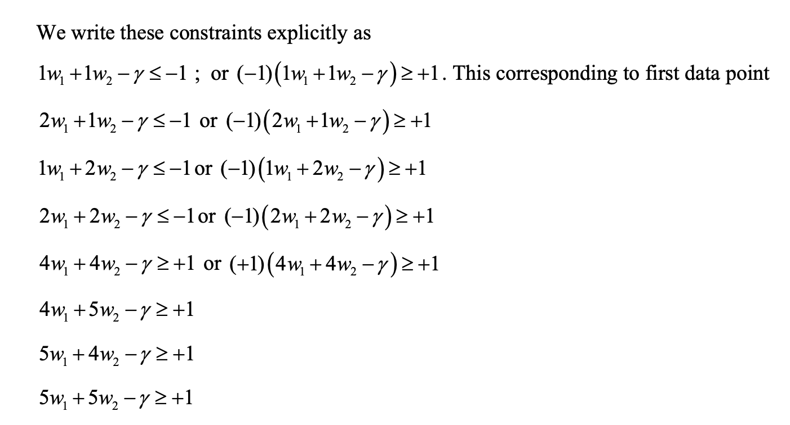
SVM formulation with two variables

Slide 23
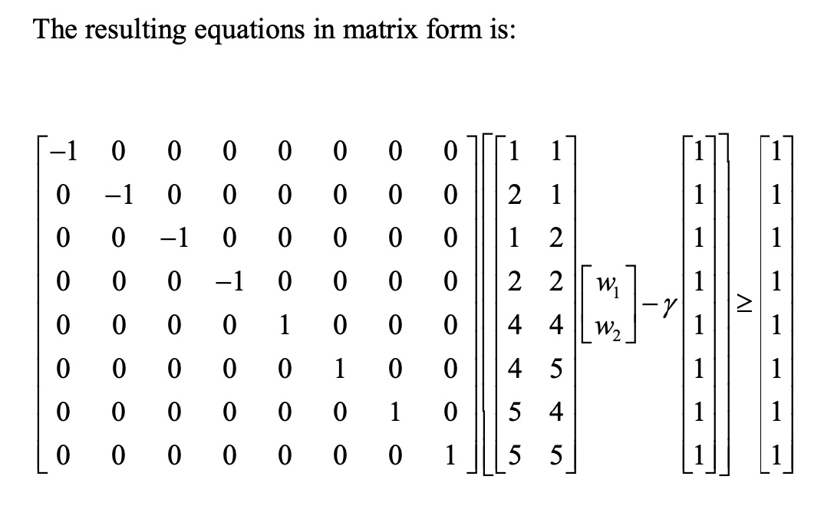
SVM formulation with two variables

Slide 24
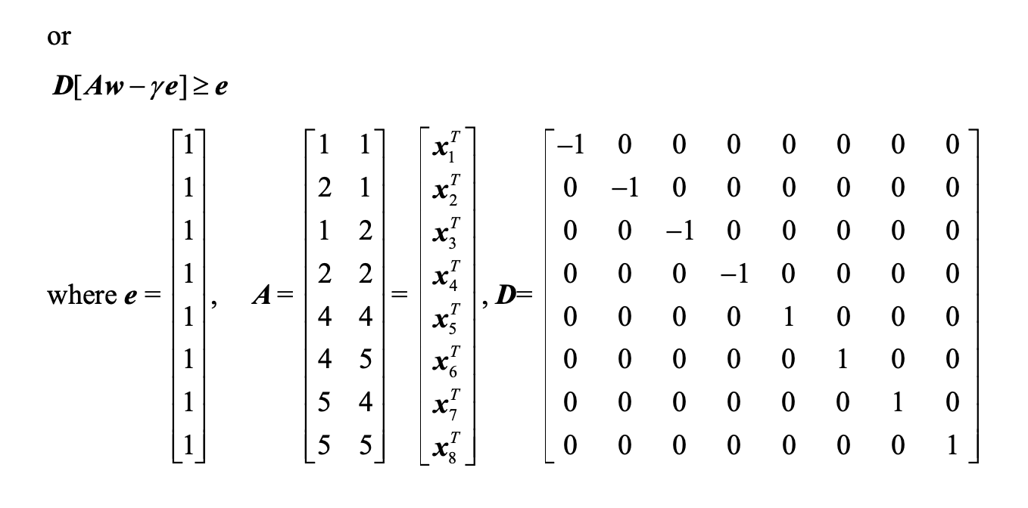
SVM formulation with two variables

Slide 25
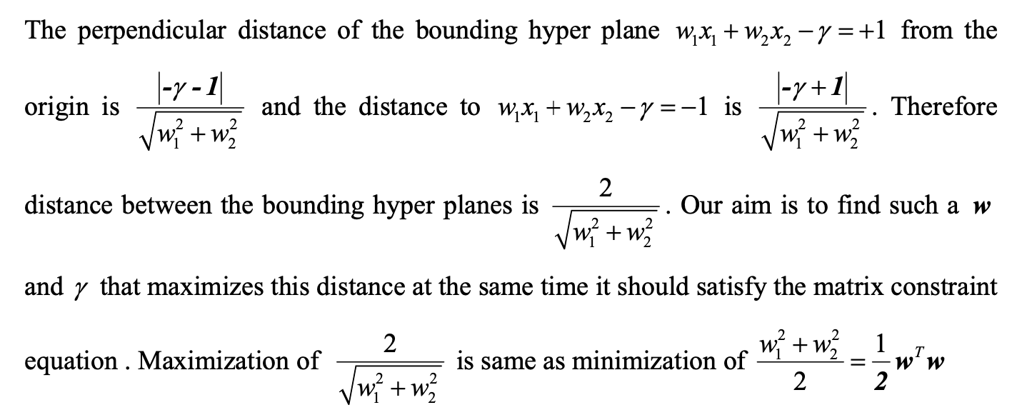
SVM formulation with two variables

Slide 26
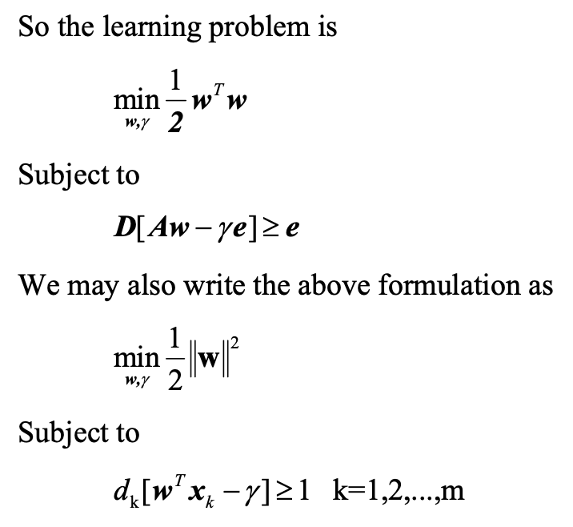
SVM formulation with two variables

Slide 27
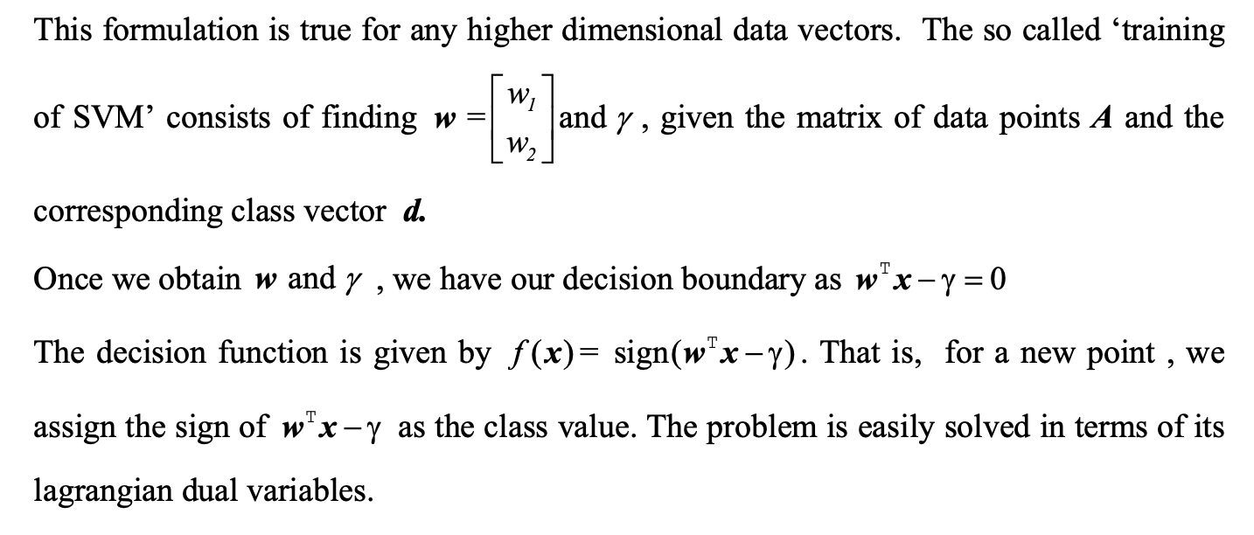
SVM formulation with two variables

Slide 28
SVM formulation with two variables

Slide 29
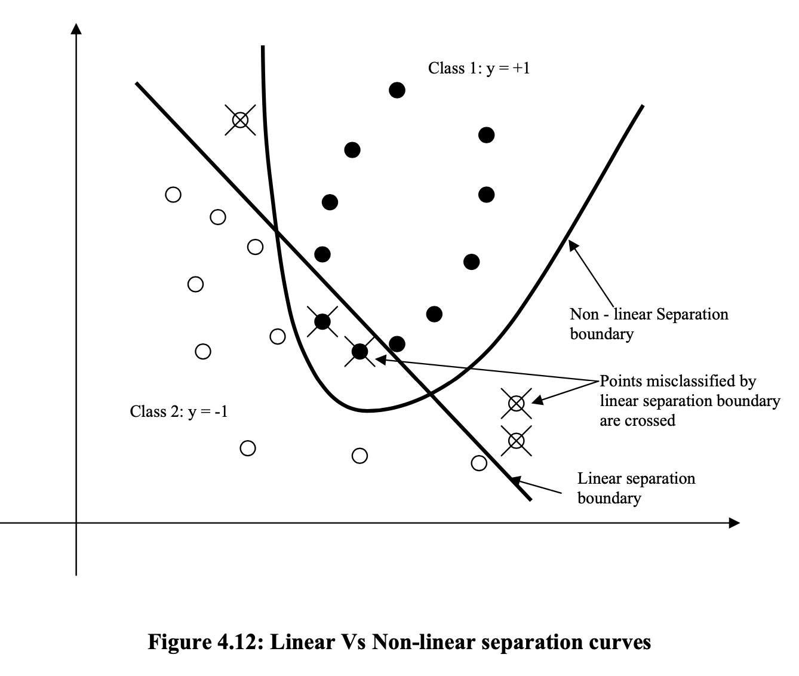
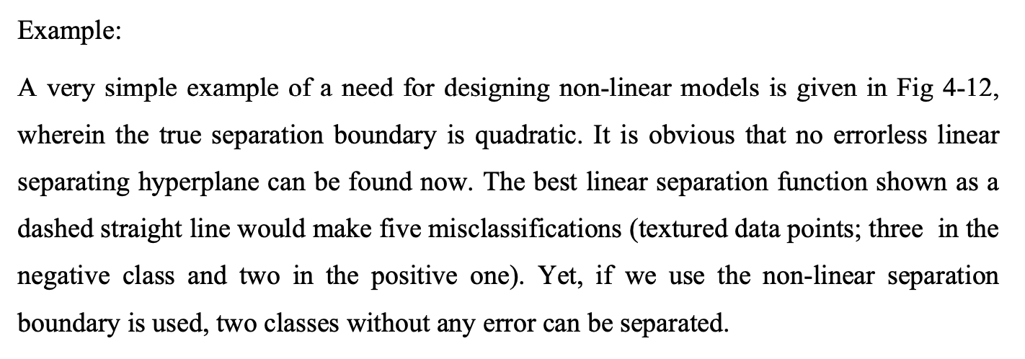
Kernel trick

Slide 30
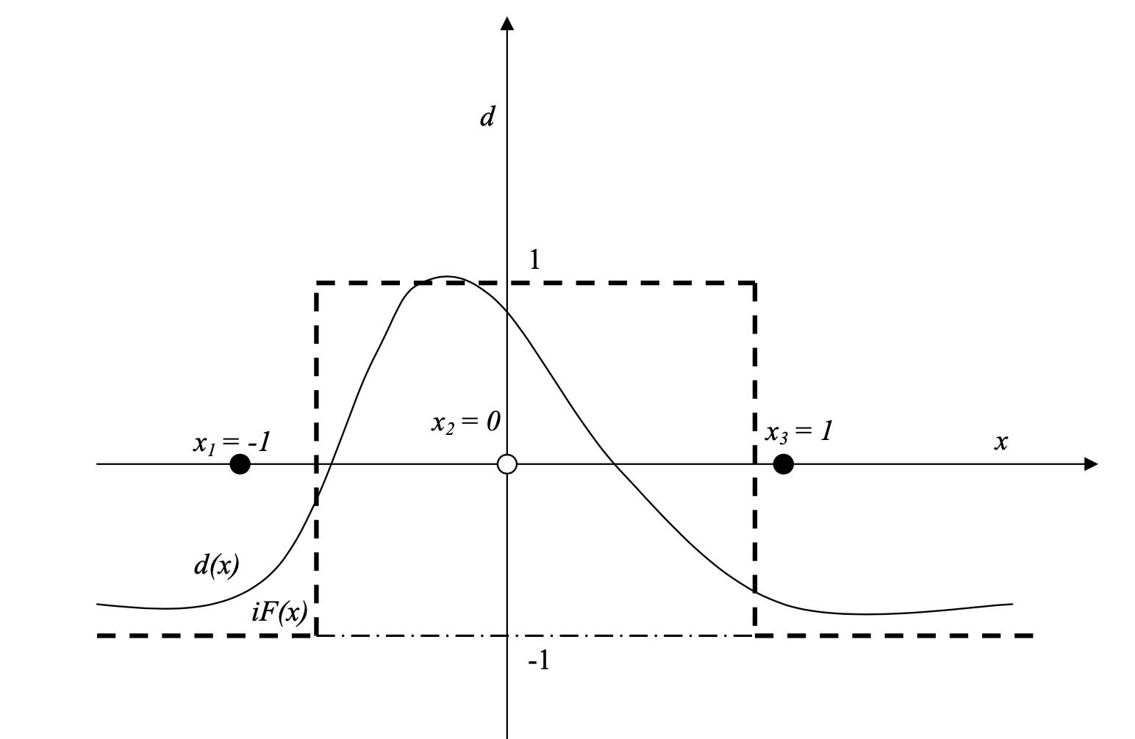
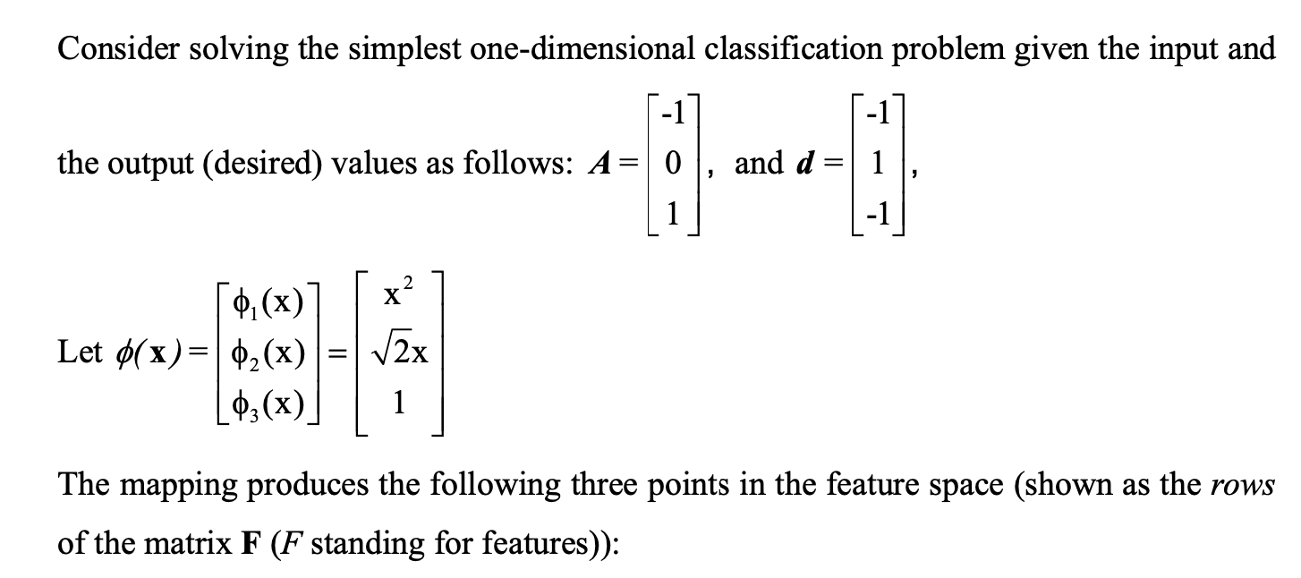
Kernel trick

Slide 31
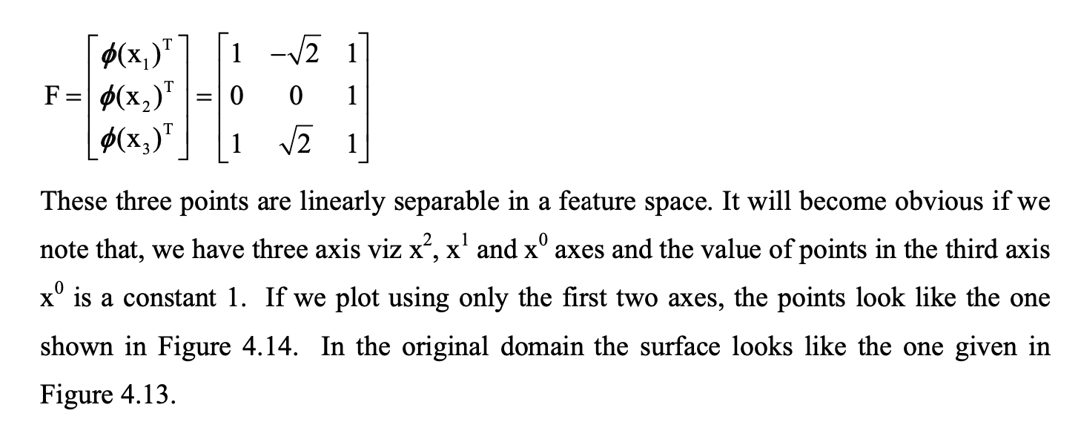
Kernel trick

Slide 32
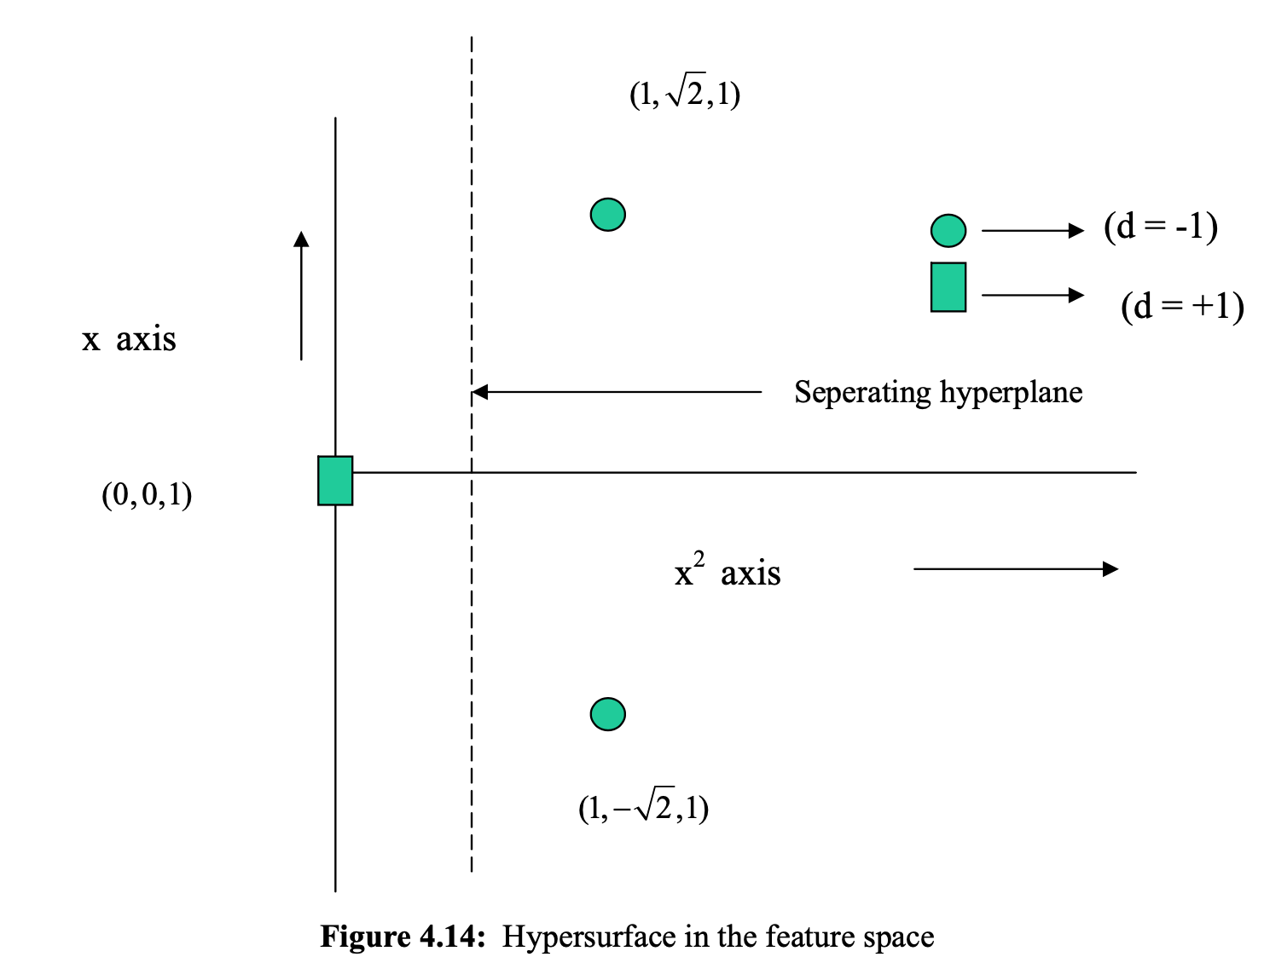
Kernel trick

Slide 33

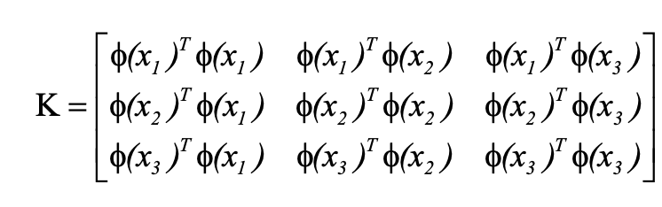
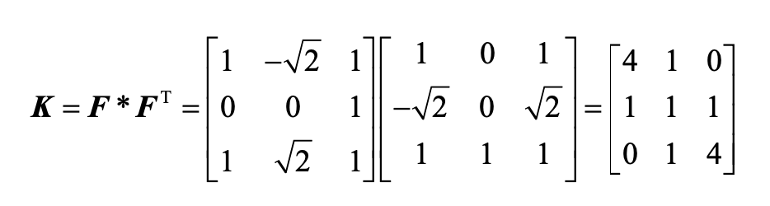
Kernel trick

Slide 34
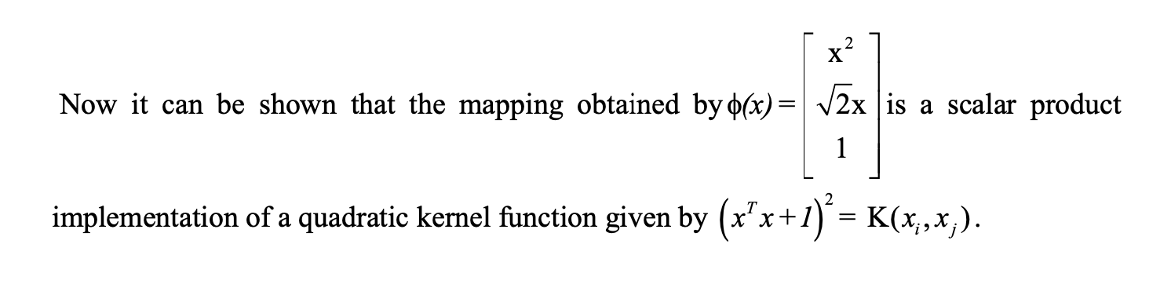
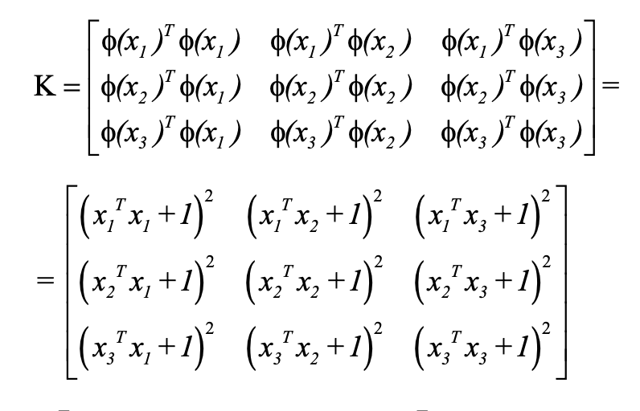
Kernel trick

Slide 35
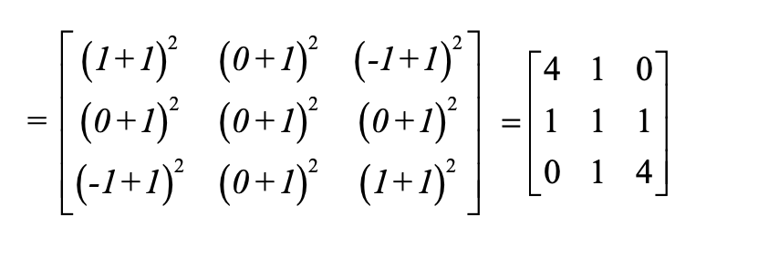
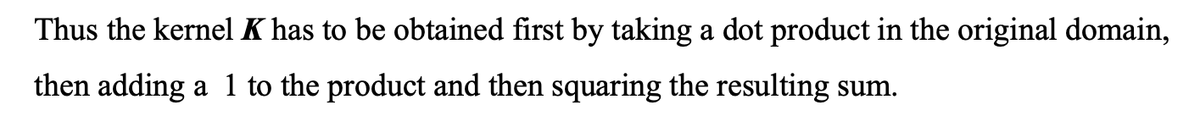
Kernel trick

Slide 36
Lab Exercise:
For the simple 8 point dataset that is discussed in this presentation, implement SVM algorithm in python, find out the vector ‘w = [w1, w2] and γ. Plot the data points and hyperplane and bounding plane to visualize the data points with this support vectors, decision boundary.
Implement SVM algorithm for IRIS dataset and any other dataset of your choice.

Slide 37
Thanks
Notes:
https://www.amrita.edu/news/amrita-surya-vahini-solar-auto-rickshaw

